Slide 1
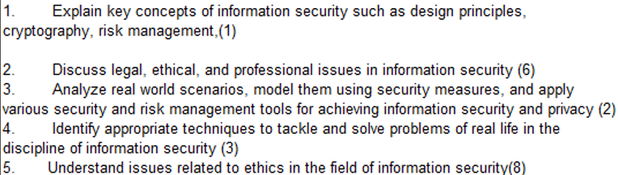
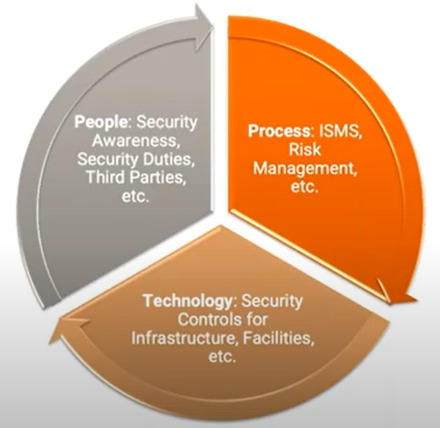
CS 3002 Information Security
Fall 2024
Week # 9 – Lecture #27, 28 and 29
15 , 16 and 17th October 2024
Dr. Aqsa Aslam

Slide 2
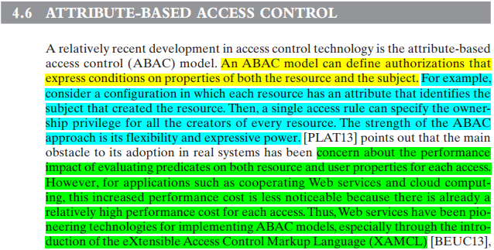
(ABAC)

Slide 3
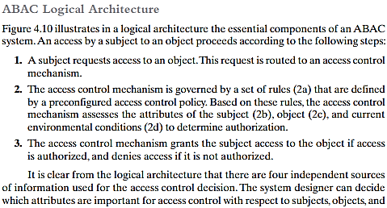
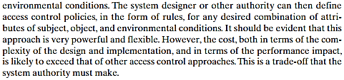

Slide 4
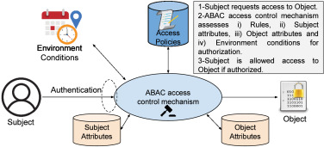
There are three key elements to an ABAC model: attributes, which are defined for entities in a configuration; a policy model, which defines the ABAC policies; and the architecture model, which applies to policies that enforce access control.
https://www.sciencedirect.com/science/article/pii/S0167739X22000115

Slide 5
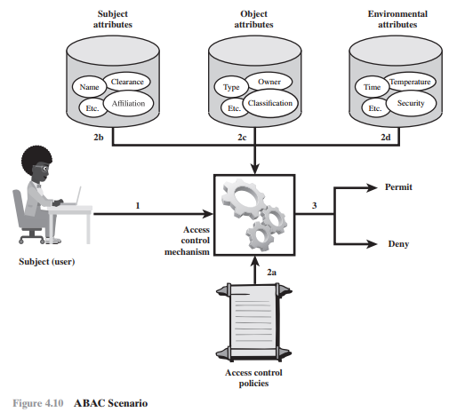
ABAC is a logical access control model that is distinguishable because it controls access to objects by evaluating rules against the attributes of entities (subject and object), operations, and the environment relevant to a request.
ABAC relies upon the evaluation of attributes of the subject, attributes of the object, and a formal relationship or access control rule defining the allowable operations for subject object attribute combinations in a given environment.
All ABAC solutions contain these basic core capabilities to evaluate attributes and enforce rules or relationships between those attributes.

Slide 6
ABAC Model
ABAC enables fine-grained access control, which allows for a higher number of discrete inputs into an access control decision, providing a bigger set of possible combinations of those variables to reflect a larger and more definitive set of possible rules, policies, or restrictions on access.
ABAC allows an unlimited number of attributes to be combined to satisfy any access control rule.
ABAC systems can be implemented to satisfy a wide array of requirements from basic access control lists through advanced expressive policy models that fully leverage the flexibility of ABAC.
ABAC systems are capable of enforcing DAC, RBAC, and MAC concepts.

Slide 7
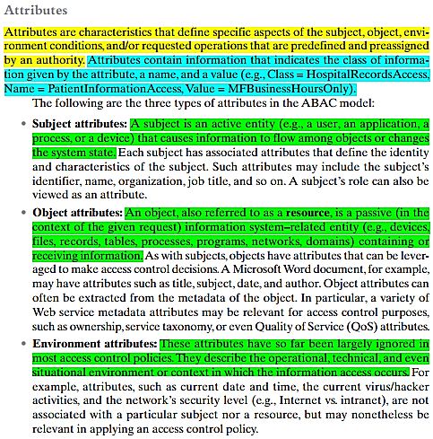
There are three key elements to an ABAC model:
attributes, which are defined for entities in a configuration;
a policy model, which defines the ABAC policies; and the
architecture model, which applies to policies that enforce access control.

Slide 8
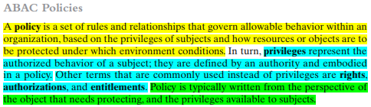

Slide 9


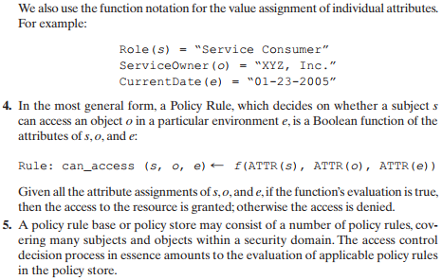
These attributes can include things like user roles, user IDs, age, group
Objects can be files, data records, resources, or anything

Slide 10
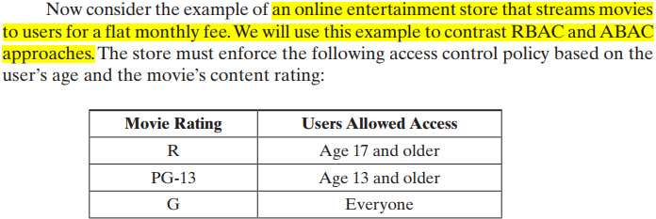
Online Entertainment Store Scenario (RBAC vs ABAC)

Slide 11
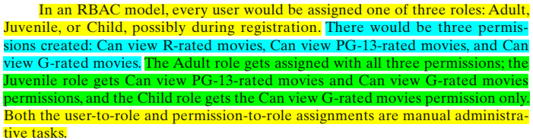
Online Entertainment Store Scenario (RBAC)

Slide 12



c

Slide 13

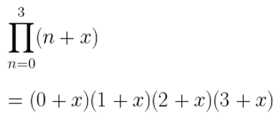
Online Entertainment Store Scenario (RBAC vs ABAC)
Question. Suppose movies are classified as either New Release or Old Release, based on release date compared to the current date, and users are classified as Premium User and Regular User, based on the fee they pay. Question: To enforce a policy that only premium users can view new movies, show RBAC and ABAC solutions.
RBAC model: we would have to double the number of roles, to distinguish each user by age and fee, and we would have to double the number of separate permissions as well. In general, if there are K subject attributes and M object attributes, and if for each attribute, Range() denotes the range of possible values it can take, then the respective number of roles and permissions required for an RBAC model are:
Thus, we can see that as the number of attributes increases to accommodate finer-grained policies, the number of roles and permissions grows exponentially.

Slide 14

Online Entertainment Store Scenario (RBAC vs ABAC)
ABAC model: deals with additional attributes in an efficient way. For this example, the policy R1 defined previously still applies. We need two new rules:
We can also add environmental attributes as follows:
Suppose we wish to add a new policy rule that is expressed in words as follows: Regular users are allowed to view new releases in promotional periods. we only need to add a conjunctive (AND) rule that checks to see the environmental attribute today’s date falls in a promotional period.
This would be difficult to express in an RBAC model.

Slide 15
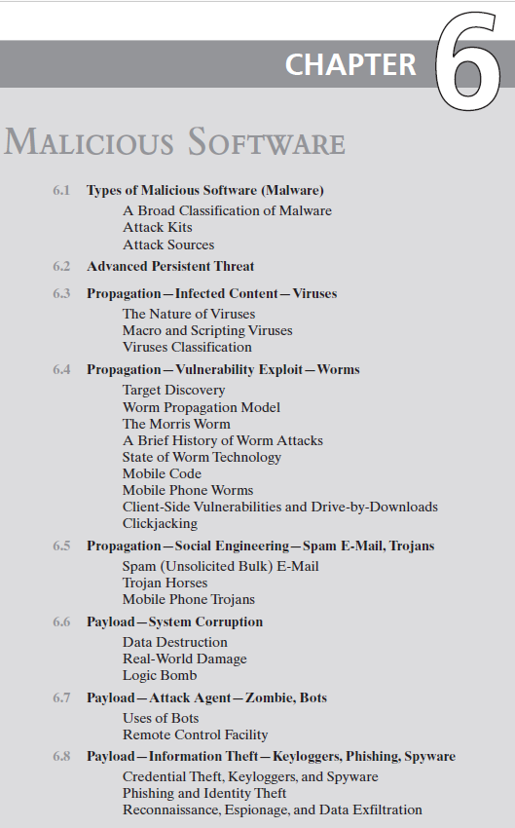
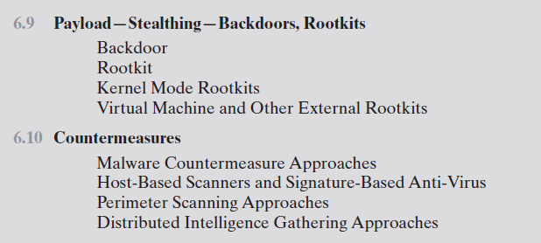
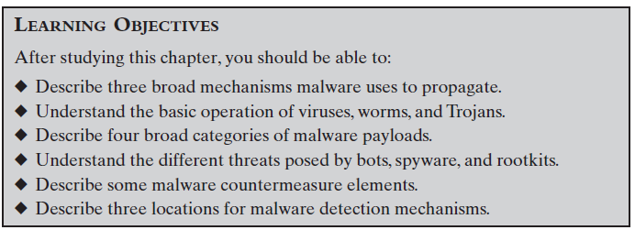
15

Slide 16
Malware
NIST 800-83 defines malware as:
“a program that is inserted into a system, usually covertly, with the intent of compromising the confidentiality, integrity, or availability of the victim’s data, applications, or operating system or otherwise annoying or disrupting the victim.”
Notes:
Malicious software, or malware, arguably constitutes one of the most significant categories
of threats to computer systems. NIST SP 800-83 (Guide to Malware Incident Prevention and
Handling for Desktops and Laptops, July 2013) defines malware as “a program that
is inserted into a system, usually covertly, with the intent of compromising the confidentiality,
integrity, or availability of the victim’s data, applications, or operating
system or otherwise annoying or disrupting the victim.” Hence, we are concerned
with the threat malware poses to application programs, to utility programs, such as
editors and compilers, and to kernel-level programs. We are also concerned with
its use on compromised or malicious Web sites and servers, or in especially crafted
spam e-mails or other messages, which aim to trick users into revealing sensitive
personal information.

Slide 17
Classification of Malware
Classified into two broad categories:
Based first on how it spreads or propagates to reach the desired targets
Then on the actions or payloads it performs once a target is reached
Also classified by:
Those that need a host program (parasitic code such as viruses)
Those that are independent, self-contained programs (worms, trojans, and bots)
Malware that does not replicate (trojans and spam e-mail)
Malware that does replicate (viruses and worms)
Notes:
A number of authors attempt to classify malware, as shown in the survey and proposal
of [HANS04]. Although a range of aspects can be used, one useful approach
classifies malware into two broad categories, based first on how it spreads or propagates
to reach the desired targets; and then on the actions or payloads it performs
once a target is reached.
Earlier approaches to malware classification distinguished between those that
need a host program, being parasitic code such as viruses, and those that are independent,
self-contained programs run on the system such as worms, trojans, and
bots. Another distinction used was between malware that does not replicate, such as
trojans and spam e-mail, and malware that does, including viruses and worms.

Slide 18
Types of Malicious Software (Malware)
Malware classification is based on:
How it spreads or propagates
On the actions or payloads
Infection of existing content by viruses that is subsequently spread to other systems
Exploit of software vulnerabilities by worms or drive-by-downloads to allow the malware to replicate
Social engineering attacks that convince users to bypass security mechanisms to install Trojans or to respond to phishing attacks
Payload actions performed by malware once it reaches a target system can include:
Corruption of system or data files
Theft of service/make the system a zombie agent of attack as part of a botnet
Theft of information from the system/keylogging
Stealthing/hiding its presence on the system
Propagation mechanisms include:
18
Notes:
A number of authors attempt to classify malware, as shown in the survey and proposal
of [HANS04]. Although a range of aspects can be used, one useful approach
classifies malware into two broad categories, based first on how it spreads or propagates
to reach the desired targets; and then on the actions or payloads it performs
once a target is reached.
Earlier approaches to malware classification distinguished between those that
need a host program, being parasitic code such as viruses, and those that are independent,
self-contained programs run on the system such as worms, trojans, and
bots. Another distinction used was between malware that does not replicate, such as
trojans and spam e-mail, and malware that does, including viruses and worms.

Slide 19
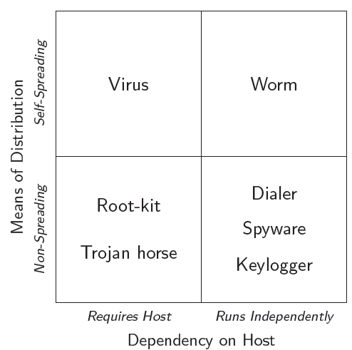

Taxonomy I

Slide 20
Taxonomy II
Virus
Self-replicating
Needs a host to infect
Boot (Brain virus), overwrite, parasitic, cavity, entry point obfuscation, code integration (W95/Zmist virus)
Worm
Self-replicating, spreads (autonomously) over network
Exploits vulnerabilities affecting a large number of hosts
Sends itself via email
e.g., Internet worm, Netsky, Sobig, Code Red, Blaster, Slammer

Slide 21
Taxonomy III
Trojan horse
Malicious program disguised as a legitimate software
Many dierent malicious actions
Spy on sensitive user data
Hide presence (e.g., root-kit)
Allow remote access (e.g., Back Orice, NetBus)
Root-kit
Used to keep access to a compromised system
Usually hides files, processes, network connections
User- and kernel-level (very sophisticated and can hide drivers)

Slide 22
Piece of software that infects programs
Modifies them to include a copy of the virus
The modification includes injecting the original code with a routine to make copies of the virus code, which can then goon to infect other content
Replicates and goes on to infect other content
Virus becomes embedded in a program, or carrier of executable content, on a computer. whenever the infected computer comes into contact with an uninfected piece of code, a fresh copy of the virus passes into the new location.
A virus that attaches to an executable program can do anything that the program is permitted to do.
It executes secretly when the host program is run.
Once the virus code is executing, it can perform any function (e.g., erasing files and program etc
Examples of viruses include Creeper, Blaster, Slammer, etc.

Slide 23
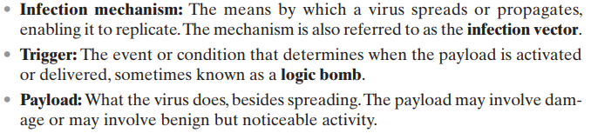
A computer virus (and many types of current malware) has three components:

Slide 24
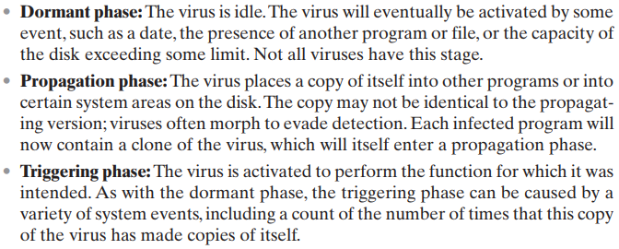

A typical virus goes through the following four phases during its lifetime:

Slide 25
A worm is a program that actively seeks out new machines to infect and uses them to launch further attacks on other systems.
Worms exploit flaws in client or server software to gain access to systems, often using network connections to propagate.
Phases (Similar to Viruses):
Dormant Phase: The worm is inactive, waiting for a trigger.
Propagation Phase: The worm replicates itself and seeks to infect other systems by exploiting access mechanisms.
Triggering Phase: The worm is activated by certain events (e.g., a date or system event).
Execution Phase: The worm carries out its payload, which could range from harmless to destructive actions.
Propagation Actions: Searches for access mechanisms like host tables, address books, buddy lists, trusted peers, target host addresses, or removable media.
Uses discovered mechanisms to transfer and run copies of itself on other systems.
Advanced Features: Some worms check if a system is already infected before copying themselves.
They can disguise their presence by using system process names or injecting their code into existing processes with additional threads.
Notes:
The next category of malware propagation concerns the exploit of software
vulnerabilities, such as those we discuss in Chapters 10 and 11 , which are commonly
exploited by computer worms. A worm is a program that actively seeks out
more machines to infect, and then each infected machine serves as an automated
launching pad for attacks on other machines. Worm programs exploit software
vulnerabilities in client or server programs to gain access to each new system. They
can use network connections to spread from system to system. They can also spread
through shared media, such as USB drives or CD and DVD data disks. E-mail
worms spread in macro or script code included in documents attached to e-mail or
to instant messenger file transfers. Upon activation, the worm may replicate and
propagate again. In addition to propagation, the worm usually carries some form of
payload, such as those we discuss later.
The concept of a computer worm was introduced in John Brunner’s 1975 SF
novel The Shockwave Rider . The first known worm implementation was done in
Xerox Palo Alto Labs in the early 1980s. It was nonmalicious, searching for idle
systems to use to run a computationally intensive task.

Slide 26
Spread Mechanisms:
Electronic mail or instant messenger facility
Worms send themselves via email or as attachments in instant messaging, activated when the file is opened.
File sharing
Worms spread through infected removable media (e.g., USB drives), exploiting vulnerabilities like autorun or user interactions.
Remote execution capability
Worms exploit network service vulnerabilities or use remote execution tools to run themselves on other systems.
Remote file access or transfer capability
Worms copy themselves via remote file transfer services, executed by users on the target system.
Remote login capability
Worms log into remote systems, copying themselves to be executed on the remote machine.
Notes:
To replicate itself, a worm uses some means to access remote systems. These
include the following, most of which are still seen in active use:
• Electronic mail or instant messenger facility: A worm e-mails a copy of itself to
other systems, or sends itself as an attachment via an of instant message service,
so that its code is run when the e-mail or attachment is received or viewed.
• File sharing: A worm either creates a copy of itself or infects other suitable
files as a virus on removable media such as a USB drive; it then executes when
the drive is connected to another system using the autorun mechanism by
exploiting some software vulnerability, or when a user opens the infected file
on the target system.
• Remote execution capability: A worm executes a copy of itself on another
system, either by using an explicit remote execution facility or by exploiting a
program flaw in a network service to subvert its operations (as we discuss in
Chapters 10 and 11 ).
• Remote file access or transfer capability: A worm uses a remote file access or
transfer service to another system to copy itself from one system to the other,
where users on that system may then execute it.
• Remote login capability: A worm logs onto a remote system as a user and
then uses commands to copy itself from one system to the other, where it then
executes.
The new copy of the worm program is then run on the remote system where, in
addition to any payload functions that it performs on that system, it continues to
propagate.
A worm typically uses the same phases as a computer virus: dormant, propagation,
triggering, and execution. The propagation phase generally performs the
following functions:
• Search for appropriate access mechanisms to other systems to infect by examining
host tables, address books, buddy lists, trusted peers, and other similar
repositories of remote system access details; by scanning possible target host
addresses; or by searching for suitable removable media devices to use.
• Use the access mechanisms found to transfer a copy of itself to the remote
system, and cause the copy to be run.
The worm may also attempt to determine whether a system has previously
been infected before copying itself to the system. In a multiprogramming system,
it can also disguise its presence by naming itself as a system process or using some
other name that may not be noticed by a system operator. More recent worms can
even inject their code into existing processes on the system, and run using additional
threads in that process, to further disguise their presence.

Slide 27
Recent Worm Attacks
Melissa | 1998 | E-mail worm First to include virus, worm and Trojan in one package
Code Red | July 2001 | Exploited Microsoft IIS bug Probes random IP addresses Consumes significant Internet capacity when active
Code Red II | August 2001 | Also targeted Microsoft IIS Installs a backdoor for access
Nimda | September 2001 | Had worm, virus and mobile code characteristics Spread using e-mail, Windows shares, Web servers, Web clients, backdoors
SQL Slammer | Early 2003 | Exploited a buffer overflow vulnerability in SQL server compact and spread rapidly
Sobig.F | Late 2003 | Exploited open proxy servers to turn infected machines into spam engines
Mydoom | 2004 | Mass-mailing e-mail worm Installed a backdoor in infected machines
Warezov | 2006 | Creates executables in system directories Sends itself as an e-mail attachment Can disable security related products
Conficker (Downadup) | November 2008 | Exploits a Windows buffer overflow vulnerability Most widespread infection since SQL Slammer
Stuxnet | 2010 | Restricted rate of spread to reduce chance of detection Targeted industrial control systems
Notes:
The Melissa e-mail worm that appeared in 1998 was the first of a new generation of
malware that included aspects of virus, worm, and Trojan in one package [CASS01].
Melissa made use of a Microsoft Word macro embedded in an attachment. If the
recipient opens the e-mail attachment, the Word macro is activated. Then it
1. Sends itself to everyone on the mailing list in the user’s e-mail package, propagating
as a worm; and
2. Does local damage on the user’s system, including disabling some security
tools, and also copying itself into other documents, propagating as a
virus; and
3. If a trigger time was seen, it displayed a Simpson quote as its payload.
In 1999, a more powerful version of this e-mail virus appeared. This version
could be activated merely by opening an e-mail that contains the virus, rather
than by opening an attachment. The virus uses the Visual Basic scripting language
supported by the e-mail package.
Melissa propagates itself as soon as it is activated (either by opening an e-mail
attachment or by opening the e-mail) to all of the e-mail addresses known to the
infected host. As a result, whereas viruses used to take months or years to propagate,
this next generation of malware could do so in hours. [CASS01] notes that it
took only three days for Melissa to infect over 100,000 computers, compared to the
months it took the Brain virus to infect a few thousand computers a decade before.
This makes it very difficult for anti-virus software to respond to new attacks before
much damage is done.
The Code Red worm first appeared in July 2001. Code Red exploits a security
hole in the Microsoft Internet Information Server (IIS) to penetrate and spread.
It also disables the system file checker in Windows. The worm probes random IP
addresses to spread to other hosts. During a certain period of time, it only spreads.
It then initiates a denial-of-service attack against a government Web site by flooding
the site with packets from numerous hosts. The worm then suspends activities
and reactivates periodically. In the second wave of attack, Code Red infected nearly
360,000 servers in 14 hours. In addition to the havoc it caused at the targeted server,
Code Red consumed enormous amounts of Internet capacity, disrupting service
[MOOR02].
Code Red II is another, distinct, variant that first appeared in August 2001,
and also targeted Microsoft IIS. It tried to infect systems on the same subnet as the
infected system. Also, this newer worm installs a backdoor, allowing a hacker to
remotely execute commands on victim computers.
The Nimda worm that appeared in September 2001 also has worm, virus, and
mobile code characteristics. It spread using a variety of distribution methods:
• E-mail: A user on a vulnerable host opens an infected e-mail attachment;
Nimda looks for e-mail addresses on the host and then sends copies of itself to
those addresses.
• Windows shares: Nimda scans hosts for unsecured Windows file shares; it can
then use NetBIOS86 as a transport mechanism to infect files on that host in
the hopes that a user will run an infected file, which will activate Nimda on
that host.
• Web servers: Nimda scans Web servers, looking for known vulnerabilities in
Microsoft IIS. If it finds a vulnerable server, it attempts to transfer a copy of
itself to the server and infects it and its files.
Web clients: If a vulnerable Web client visits a Web server that has been
infected by Nimda, the client’s workstation will become infected.
• Backdoors: If a workstation was infected by earlier worms, such as “Code Red
II,” then Nimda will use the backdoor access left by these earlier infections to
access the system.
In early 2003, the SQL Slammer worm appeared. This worm exploited a
buffer overflow vulnerability in Microsoft SQL server. The Slammer was extremely
compact and spread rapidly, infecting 90% of vulnerable hosts within 10 minutes.
This rapid spread caused significant congestion on the Internet.
Late 2003 saw the arrival of the Sobig.F worm, which exploited open proxy
servers to turn infected machines into spam engines. At its peak, Sobig.F reportedly
accounted for one in every 17 messages and produced more than one million copies
of itself within the first 24 hours.
Mydoom is a mass-mailing e-mail worm that appeared in 2004. It followed
a growing trend of installing a backdoor in infected computers, thereby enabling
hackers to gain remote access to data such as passwords and credit card numbers.
Mydoom replicated up to 1,000 times per minute and reportedly flooded the
Internet with 100 million infected messages in 36 hours.
The Warezov family of worms appeared in 2006 [KIRK06]. When the worm
is launched, it creates several executables in system directories and sets itself to
run every time Windows starts by creating a registry entry. Warezov scans several
types of files for e-mail addresses and sends itself as an e-mail attachment. Some
variants are capable of downloading other malware, such as Trojan horses and
adware. Many variants disable security-related products and/or disable their
updating capability.
The Conficker (or Downadup) worm was first detected in November 2008
and spread quickly to become one of the most widespread infections since SQL
Slammer in 2003 [LAWT09]. It spread initially by exploiting a Windows buffer
overflow vulnerability, though later versions could also spread via USB drives and
network file shares. In 2010, it still comprised the second most common family of
malware observed by Symantec [SYMA16], even though patches were available
from Microsoft to close the main vulnerabilities it exploits.
In 2010, the Stuxnet worm was detected, though it had been spreading quietly
for some time previously [CHEN11, KUSH13]. Unlike many previous worms, it deliberately
restricted its rate of spread to reduce its chance of detection. It also targeted industrial
control systems, most likely those associated with the Iranian nuclear program,
with the likely aim of disrupting the operation of their equipment. It supported a
range of propagation mechanisms, including via USB drives, network file shares,
and using no less than four unknown, zero-day vulnerability exploits. Considerable
debate resulted from the size and complexity of its code, the use of an unprecedented
four zero-day exploits, and the cost and effort apparent in its development.
There are claims that it appears to be the first serious use of a cyberwarfare weapon
against a nation’s physical infrastructure. The researchers at Symantec who analyzed
Stuxnet noted that while they were expecting to find espionage, they never expected
to see malware with targeted sabotage as its aim. As a result, greater attention is now
being directed at the use of malware as a weapon by a number of nations.
In late 2011 the Duqu worm was discovered, which uses code related to that in
Stuxnet. Its aim is different, being cyber-espionage, though it appears to also target
the Iranian nuclear program. Another prominent, recent, cyber-espionage worm is
the Flame family, which was discovered in 2012 and appears to target Middle-Eastern
countries. Despite the specific target areas for these various worms, their infection
strategies have been so successful that they have been identified on computer systems
in a very large number of countries, including on systems kept physically isolated
from the general Internet. This reinforces the need for significantly improved
countermeasures to resist such infections.

Slide 28
WannaCry
Ransomware attack in May 2017 that spread extremely fast over a period of hours to days, infecting hundreds of thousands of systems belonging to both public and private organizations in more than 150 countries
It spread as a worm by aggressively scanning both local and random remote networks, attempting to exploit a vulnerability in the Server Message Block protocol file sharing service on unpatched Windows systems
This rapid spread was only slowed by the accidental activation of a “kill-switch” domain by a UK security researcher
Once installed on infected systems, it also encrypted files, demanding a ransom payment to recover them
Notes:
In May 2017, the WannaCry ransomware attack spread extremely rapidly over a
period of hours to days, infecting hundreds of thousands of systems belonging to both
public and private organisations in more than 150 countries (US-CERT Alert TA17-
132A) [GOOD17]. It spread as a worm by aggressively scanning both local and random
remote networks, attempting to exploit a vulnerability in the SMB file sharing service on
unpatched Windows systems. This rapid spread was only slowed by the accidental activation
of a “kill-switch” domain by a UK security researcher, whose existence was checked
for in the initial versions of this malware. Once installed on infected systems, it also
encrypted files, demanding a ransom payment to recover them, as we will discuss later.

Slide 29
Worm Technology
Multi-exploit
Ultrafast spreading
Polymorphic
Metamorphic
Multiplatform
Notes:
The state of the art in worm technology includes the following:
• Multiplatform: Newer worms are not limited to Windows machines but can
attack a variety of platforms, especially the popular varieties of UNIX; or
exploit macro or scripting languages supported in popular document types.
• Multi-exploit: New worms penetrate systems in a variety of ways, using exploits
against Web servers, browsers, e-mail, file sharing, and other network-based
applications; or via shared media.
• Ultrafast spreading: Exploit various techniques to optimize the rate of spread
of a worm to maximize its likelihood of locating as many vulnerable machines
as possible in a short time period.
• Polymorphic: To evade detection, skip past filters, and foil real-time analysis,
worms adopt the virus polymorphic technique. Each copy of the worm has
new code generated on the fly using functionally equivalent instructions and
encryption techniques.
• Metamorphic: In addition to changing their appearance, metamorphic worms
have a repertoire of behavior patterns that are unleashed at different stages of
propagation.
• Transport vehicles: Because worms can rapidly compromise a large number of
systems, they are ideal for spreading a wide variety of malicious payloads, such as
distributed denial-of-service bots, rootkits, spam e-mail generators, and spyware.
• Zero-day exploit : To achieve maximum surprise and distribution, a worm
should exploit an unknown vulnerability that is only discovered by the general
network community when the worm is launched. In 2015, 54 zero-day exploits were
discovered and exploited, significantly more than in previous years [SYMA16].
Many of these were in common computer and mobile software. Some, though,
were in common libraries and development packages, and some in industrial
control systems. This indicates the range of systems being targeted.

Slide 30
State of the Art in Worm Technology
Multiplatform: Targets various operating systems, including UNIX.
Multi-exploit: Uses multiple vulnerabilities across various applications.
Ultrafast Spreading: Rapid propagation to maximize reach.
Polymorphic: Dynamically alters code to evade detection.
Metamorphic: Changes appearance and behavior during propagation.
Transport Vehicles: Distributes various malicious payloads.
Zero-day Exploit: Utilizes unknown vulnerabilities for surprise attacks.

Slide 31
Mobile Code
NIST SP 800-28 defines mobile code as:
Definition: Mobile code refers to programs (e.g., scripts, macros) that can be executed unchanged across different platforms with identical semantics.
Execution: It is transmitted from a remote system to a local system and executed without explicit user instruction, often serving as a vector for malware like viruses, worms, or Trojan horses.
Exploitation: Mobile code can exploit vulnerabilities to gain unauthorized access to data or achieve root compromise.
Popular vehicles include:
Java applets
ActiveX
JavaScript
VBScript
Most common ways of using mobile code for malicious operations on local system are:
Cross-site scripting
Interactive and dynamic Web sites
E-mail attachments
Downloads from untrusted sites or of untrusted software
Notes:
NIST SP 800-28 (Guidelines on Active Content and Mobile Code , March 2008) defines
mobile code as programs (e.g., script, macro, or other portable instruction) that can
be shipped unchanged to a heterogeneous collection of platforms and executed with
identical semantics.
Mobile code is transmitted from a remote system to a local system and then
executed on the local system without the user’s explicit instruction [SOUP13]. Mobile
code often acts as a mechanism for a virus, worm, or Trojan horse to be transmitted to
the user’s workstation. In other cases, mobile code takes advantage of vulnerabilities
to perform its own exploits, such as unauthorized data access or root compromise.
Popular vehicles for mobile code include Java applets, ActiveX, JavaScript, and
VBScript. The most common ways of using mobile code for malicious operations on
local system are cross-site scripting, interactive and dynamic Web sites, e-mail attachments,
and downloads from untrusted sites or of untrusted software.

Slide 32
Mobile Phone Worms
First discovery was Cabir worm in 2004
Then Lasco and CommWarrior in 2005
Communicate through Bluetooth wireless connections or MMS
Target is the smartphone
Can completely disable the phone, delete data on the phone, or force the device to send costly messages
CommWarrior replicates by means of Bluetooth to other phones, sends itself as an MMS file to contacts and as an auto reply to incoming text messages
Notes:
Worms first appeared on mobile phones with the discovery of the Cabir worm in
2004, and then Lasco and CommWarrior in 2005. These worms communicate through
Bluetooth wireless connections or via the multimedia messaging service (MMS).
The target is the smartphone, which is a mobile phone that permits users to install
software applications from sources other than the cellular network operator. All
these early mobile worms targeted mobile phones using the Symbian operating
system. More recent malware targets Android and iPhone systems. Mobile phone
malware can completely disable the phone, delete data on the phone, or force the
device to send costly messages to premium-priced numbers.
The CommWarrior worm replicates by means of Bluetooth to other phones
in the receiving area. It also sends itself as an MMS file to numbers in the phone’s
address book and in automatic replies to incoming text messages and MMS messages.
In addition, it copies itself to the removable memory card and inserts itself
into the program installation files on the phone.
Although these examples demonstrate that mobile phone worms are possible,
the vast majority of mobile phone malware observed use trojan apps to install themselves
[SYMA16].

Slide 33
Drive-By-Downloads
Exploits browser and plugin vulnerabilities so when the user views a webpage controlled by the attacker, it contains code that exploits the bug to download and install malware on the system without the user’s knowledge or consent
In most cases the malware does not actively propagate as a worm does
Spreads when users visit the malicious Web page
Notes:
Another approach to exploiting software vulnerabilities involves the exploit of bugs
in user applications to install malware. A common technique exploits browser vulnerabilities
so that when the user views a Web page controlled by the attacker, it
contains code that exploits the browser bug to download and install malware
on the system without the user’s knowledge or consent. This is known as a drive-by-download
and is a common exploit in recent attack kits. Multiple vulnerabilities in the Adobe Flash
Player and Oracle Java plugins have been exploited by attackers over many years, to
the point where many browsers are now removing support for them. In most cases, this
malware does not actively propagate as a worm does, but rather waits for unsuspecting
users to visit the malicious webpage in order to spread to their systems [SYMA16].

Slide 34
Watering-Hole Attacks
Definition: A variant of drive-by download, targeting specific individuals or organizations by compromising websites they are likely to visit.
The attacker researches victims to find their frequently visited websites.
They scan these sites for exploitable vulnerabilities.
The attacker waits for a victim to visit a compromised site.
Attack code may be designed to infect only the target organization's systems, remaining dormant for others.
Notes:
In general, drive-by-download attacks are aimed at anyone who visits a compromised
site and is vulnerable to the exploits used. Watering-hole attacks are a
variant of this used in highly targeted attacks. The attacker researches
their intended victims to identify web sites they are likely to visit, and then scans
these sites to identify those with vulnerabilities that allow their compromise with
a drive-by-download attack. They then wait for one of their intended victims to
visit one of the compromised sites. Their attack code may even be written so that it
will only infect systems belonging to the target organization, and take no action for
other visitors to the site. This greatly increases the likelihood of the site compromise
remaining undetected.

Slide 35
Malvertising
Process: Attackers pay for ads that are likely to appear on targeted websites, embedding malware within these ads.
Visitors to the sites displaying these ads can be infected with malware.
Using these malicious ads, attackers can infect visitors to sites displaying them
The malware code may be dynamically generated to either reduce the chance of detection or to only infect specific systems
Has grown rapidly in recent years because they are easy to place on desired websites with few questions asked and are hard to track
Attackers can place these ads for as little as a few hours, when they expect their intended victims could be browsing the targeted websites, greatly reducing their visibility
Definition: A technique for placing malware on websites without compromising them by using malicious advertisements.
Notes:
Malvertising is another technique used to place malware on websites without
actually compromising them. The attacker pays for advertisements that
are highly likely to be placed on their intended target websites, and which incorporate
malware in them. Using these malicious adds, attackers can infect visitors to
sites displaying them. Again, the malware code may be dynamically generated to
either reduce the chance of detection, or to only infect specific systems.
Malvertising has grown rapidly in recent years, as they are easy to place on desired websites with few questions asked,
and are hard to track. Attackers have placed these ads for as little as a few hours,
when they expect their intended victims could be browsing the targeted websites,
greatly reducing their visibility [SYMA16].
Other malware may target common PDF viewers to also download and install
malware without the user’s consent when they view a malicious PDF document
[STEV11]. Such documents may be spread by spam e-mail, or be part of a targeted
phishing attack, as we will discuss in the next section.

Slide 36
Clickjacking
Definition: Clickjacking, or user-interface (UI) redress attack, is a vulnerability that allows attackers to capture a user's clicks without their consent.
Mechanism:
Attackers can manipulate user actions, leading to unintended consequences such as changing computer settings or redirecting users to malicious websites.
Using Adobe Flash or JavaScript, attackers can place hidden buttons over legitimate buttons, making detection difficult.
Typical Attack Method:
Multiple transparent or opaque layers are employed to trick users into clicking on a button or link on another page instead of the intended one, effectively hijacking clicks meant for the visible interface.
Keystroke Hijacking:
Similar techniques can hijack keystrokes by using a combination of stylesheets, iframes, and text boxes, causing users to unknowingly input sensitive information into an invisible frame controlled by the attacker.
Evolution of Techniques:
A variety of techniques exist for executing clickjacking attacks, with new methods continuously developed to counteract defenses against older tactics.
Notes:
Clickjacking, also known as a user-interface (UI) redress attack , is a vulnerability
used by an attacker to collect an infected user’s clicks. The attacker can force the
user to do a variety of things from adjusting the user’s computer settings to unwittingly
sending the user to Web sites that might have malicious code. Also, by taking
advantage of Adobe Flash or JavaScript, an attacker could even place a button
under or over a legitimate button, making it difficult for users to detect. A typical
attack uses multiple transparent or opaque layers to trick a user into clicking on a
button or link on another page when they were intending to click on the top level
page. Thus, the attacker is hijacking clicks meant for one page and routing them to
another page, most likely owned by another application, domain, or both.
Using a similar technique, keystrokes can also be hijacked. With a carefully
crafted combination of stylesheets, iframes, and text boxes, a user can be led to
believe they are typing in the password to their email or bank account, but are
instead typing into an invisible frame controlled by the attacker.
There is a wide variety of techniques for accomplishing a clickjacking attack,
and new techniques are developed as defenses to older techniques are put in place.
[NIEM11] and [STON10] are useful discussions.

Slide 37

“Tricking” users to assist in the compromise of their own systems
Spam
Unsolicited bulk
e-mail
Significant carrier of malware
Used for phishing attacks
Trojan horse
Program or utility containing harmful hidden code
Used to accomplish functions that the attacker could not accomplish directly
Mobile phone Trojans
First appeared in 2004 (Skuller)
Target is the smartphone
Notes:
The final category of malware propagation we consider involves social engineering,
“tricking” users to assist in the compromise of their own systems or personal
information. This can occur when a user views and responds to some SPAM
e-mail, or permits the installation and execution of some Trojan horse program or
scripting code.
Spam (Unsolicited Bulk) E-Mail
With the explosive growth of the Internet over the last few decades, the widespread
use of e-mail, and the extremely low cost required to send large volumes of e-mail, has
come the rise of unsolicited bulk e-mail, commonly known as spam. [SYMA16] notes
that more than half of inbound business e-mail traffic is still spam, despite a gradual
decline in recent years. This imposes significant costs on both the network infrastructure
needed to relay this traffic, and on users who need to filter their legitimate e-mails
out of this flood. In response to this explosive growth, there has been the equally rapid
growth of the anti-spam industry that provides products to detect and filter spam
e-mails. This has led to an arms race between the spammers devising techniques to
sneak their content through, and with the defenders, efforts to block them [KREI09].
However, the spam problem continues, as spammers exploit other means of
reaching their victims. This includes the use of social media, reflecting the rapid growth
in the use of these networks. For example, [SYMA16] described a successful weightloss
spam campaign that exploited hundreds of thousands of fake Twitter accounts,
mutually supporting and reinforcing each other, to increase their credibility and likelihood
of users following them, and then falling for the scam. Social network scams often
rely on victims sharing the scam, or on fake offers with incentives, to assist their spread.
While some spam e-mail is sent from legitimate mail servers using stolen user
credentials, most recent spam is sent by botnets using compromised user systems,
as we will discuss in Section 6.6. A significant portion of spam e-mail content is just
advertising, trying to convince the recipient to purchase some product online, such
as pharmaceuticals, or used in scams, such as stock, romance or fake trader scams, or
money mule job ads. But spam is also a significant carrier of malware. The e-mail may
have an attached document, which, if opened, may exploit a software vulnerability
to install malware on the user’s system, as we discussed in the previous section. Or, it
may have an attached Trojan horse program or scripting code that, if run, also installs
malware on the user’s system. Some Trojans avoid the need for user agreement by
exploiting a software vulnerability in order to install themselves, as we will discuss
next. Finally the spam may be used in a phishing attack, typically directing the user
either to a fake website that mirrors some legitimate service, such as an online banking
site, where it attempts to capture the user’s login and password details; or to complete
some form with sufficient personal details to allow the attacker to impersonate
the user in an identity theft. In recent years, the evolving criminal marketplace makes
phishing campaigns easier by selling packages to scammers that largely automate the
process of running the scam [SYMA16]. All of these uses make spam e-mails a significant
security concern. However, in many cases, it requires the user’s active choice
to view the e-mail and any attached document, or to permit the installation of some
program, in order for the compromise to occur. Hence the importance of providing
appropriate security awareness training to users, so they are better able to recognize
and respond appropriately to such e-mails, as we will discuss in Chapter 17.
Trojan Horses
A Trojan horse is a useful, or apparently useful, program or utility containing
hidden code that, when invoked, performs some unwanted or harmful function.
Trojan horse programs can be used to accomplish functions indirectly that
the attacker could not accomplish directly. For example, to gain access to sensitive,
personal information stored in the files of a user, an attacker could create a Trojan
horse program that, when executed, scans the user’s files for the desired sensitive
information and sends a copy of it to the attacker via a Web form or e-mail or text
message. The author could then entice users to run the program by incorporating it
into a game or useful utility program, and making it available via a known software
distribution site or app store. This approach has been used recently with utilities
that “claim” to be the latest anti-virus scanner, or security update, for systems, but
which are actually malicious Trojans, often carrying payloads such as spyware that
searches for banking credentials. Hence, users need to take precautions to validate
the source of any software they install.
Trojan horses fit into one of three models:
• Continuing to perform the function of the original program and additionally
performing a separate malicious activity
• Continuing to perform the function of the original program but modifying the
function to perform malicious activity (e.g., a Trojan horse version of a login
program that collects passwords) or to disguise other malicious activity (e.g., a
Trojan horse version of a process listing program that does not display certain
processes that are malicious)
• Performing a malicious function that completely replaces the function of the
original program
Some Trojans avoid the requirement for user assistance by exploiting some software
vulnerability to enable their automatic installation and execution. In this they share
some features of a worm, but unlike it, they do not replicate. A prominent example
of such an attack was the Hydraq Trojan used in Operation Aurora in 2009 and early
2010. This exploited a vulnerability in Internet Explorer to install itself, and targeted
several high-profile companies. It was typically distributed using either spam e-mail or
via a compromised website using a “watering-hole” attack. Tech Support Scams are a
growing social engineering concern. These involve call centers calling users about nonexistent
problems on their computer systems. If the users respond, the attackers try to
sell them bogus tech support or ask them to install Trojan malware or other unwanted
applications on their systems, all while claiming this will fix their problem [SYMA16].
Mobile Phone Trojans
Mobile phone Trojans also first appeared in 2004 with the discovery of Skuller. As
with mobile worms, the target is the smartphone, and the early mobile Trojans targeted
Symbian phones. More recently, a significant number of Trojans have been
detected that target Android phones and Apple iPhones. These Trojans are usually
distributed via one or more of the app marketplaces for the target phone O/S.
The rapid growth in smartphone sales and use, which increasingly contain valuable
personal information, make them an attractive target for criminals and other
attackers. Given five in six new phones run Android, they are a key target [SYMA16].
The number of vulnerabilities discovered in, and malware families targeting these
phones, have both increased steadily in recent years. Recent examples include a
phishing Trojan that tricks the user into entering their banking details, and ransomware
that mimics Google’s design style to appear more legitimate and intimidating.
The tighter controls that Apple impose on their app store, mean that many
iPhone Trojans target “jail-broken” phones, and are distributed via unofficial sites.
However a number of versions of the iPhone O/S contained some form of graphic
or PDF vulnerability. Indeed these vulnerabilities were the main means used to “jailbreak”
the phones. But they also provided a path that malware could use to target
the phones. While Apple has fixed a number of these vulnerabilities, new variants
continued to be discovered. This is yet another illustration of just how difficult it is, for
even well- resourced organizations, to write secure software within a complex system,
such as an operating system. We will return to this topic in Chapters 10 and 11. More
recently in 2015, XcodeGhost malware was discovered in a number of legitimate
Apple Store apps. The apps were not intentionally designed to be malicious, but their
developers used a compromised Xcode development system that covertly installed
the malware as the apps were created [SYMA16]. This is one of several examples
of attackers exploiting the development or enterprise provisioning infrastructure to
assist malware distribution.

Slide 38
Chernobyl virus
Klez
Ransomware
First seen in 1998
Infects executable files when they are opened and when a trigger date is reached, the virus deletes data on the infected system by overwriting the first megabyte of the hard drive with zeroes, resulting in massive corruption of the entire file system
Mass mailing worm infecting Windows 95 to XP systems
On trigger date causes files on the hard drive to become empty
Encrypts the user’s data and demands payment in order to access the key needed to recover the information
PC Cyborg Trojan (1989)
Mid-2006 a number of worms and Trojans appeared that used public-key cryptography with incresasingly larger key sizes to encrypt data
Example of a destructive parasitic memory-resident Windows 95 and 98 virus
First seen in October 2001
Spreads by e-mailing copies of itself to addresses found in the address book and in files on the system
It can stop and delete some anti-virus programs running on the system
The user needed to pay a ransom, or to make a purchase from certain sites, in order to receive the key to decrypt this data
Notes:
Once malware is active on the target system, the next concern is what actions it
will take on this system. That is, what payload does it carry. Some malware has a
nonexistent or nonfunctional payload. Its only purpose, either deliberate or due to
accidental early release, is to spread. More commonly, it carries one or more payloads
that perform covert actions for the attacker.
An early payload seen in a number of viruses and worms resulted in data
destruction on the infected system when certain trigger conditions were met
[WEAV03]. A related payload is one that displays unwanted messages or content
on the user’s system when triggered. More seriously, another variant attempts to
inflict real-world damage on the system. All of these actions target the integrity of
the computer system’s software or hardware, or of the user’s data. These changes
may not occur immediately, but only when specific trigger conditions are met that
satisfy their logic-bomb code.
The Chernobyl virus is an early example of a destructive parasitic memory-resident
Windows-95 and 98 virus, that was first seen in 1998. It infects executable files when
they’re opened. And when a trigger date is reached, it deletes data on the infected
system by overwriting the first megabyte of the hard drive with zeroes, resulting in
massive corruption of the entire file system. This first occurred on April 26, 1999,
when estimates suggest more than one million computers were affected.
Similarly, the Klez mass-mailing worm is an early example of a destructive
worm infecting Windows-95 to XP systems, and was first seen in October 2001. It
spreads by e-mailing copies of itself to addresses found in the address book and in
files on the system. It can stop and delete some anti-virus programs running on the
system. On trigger dates, being the 13th of several months each year, it causes files
on the local hard drive to become empty.
As an alternative to just destroying data, some malware encrypts the user’s
data, and demands payment in order to access the key needed to recover this information.
This is known as ransomware . The PC Cyborg Trojan seen in 1989 was an
early example of this. However, around mid-2006, a number of worms and Trojans
appeared, such as the Gpcode Trojan, that used public-key cryptography with increasingly
larger key sizes to encrypt data. The user needed to pay a ransom, or to make
a purchase from certain sites, in order to receive the key to decrypt this data. While
earlier instances used weaker cryptography that could be cracked without paying the
ransom, the later versions using public-key cryptography with large key sizes could
not be broken this way. [SYMA16, VERI16] note that ransomware is a growing challenge,
comprising one of the most common types of malware installed on systems,
and is often spread via “drive-by-downloads” or via SPAM e-mails.

Slide 39
Ransomware
WannaCry
Infected a large number of systems in many countries in May 2017
When installed on infected systems, it encrypted a large number of files and then demanded a ransom payment in Bitcoins to recover them
Recovery of this information was generally only possible if the organization had good backups and an appropriate incident response and disaster recovery plan
Targets widened beyond personal computer systems to include mobile devices and Linux servers
Tactics such as threatening to publish sensitive personal information, or to permanently destroy the encryption key after a short period of time, are sometimes used to increase the pressure on the victim to pay up
Notes:
The WannaCry ransomware, that we mentioned earlier in our discussion of
Worms, infected a large number of systems in many countries in May 2017. When
installed on infected systems, it encrypted a large number of files matching a list of
particular file types, and then demanded a ransom payment in Bitcoins to recover
them. Once this had occurred, recovery of this information was generally only possible
if the organization had good backups, and an appropriate incident response and disaster
recovery plan, as we will discuss in Chapter 17. The WannaCry ransomware attack
generated a significant amount of media attention, in part due to the large number of
affected organizations, and the significant costs they incurred in recovering from it. The
targets for these attacks have widened beyond personal computer systems to include
mobile devices and Linux servers. And tactics such as threatening to publish sensitive
personal information, or to permanently destroy the encryption key after a short
period of time, are sometimes used to increase the pressure on the victim to pay up.

Slide 40
Real-world damage
Causes damage to physical equipment
Chernobyl virus rewrites BIOS code
Stuxnet worm
Targets specific industrial control system software
There are concerns about using sophisticated targeted malware for industrial sabotage
Logic bomb
Code embedded in the malware that is set to “explode” when certain conditions are met
Notes:
A further variant of system corruption payloads aims to cause damage to physical
equipment. The infected system is clearly the device most easily targeted. The
Chernobyl virus mentioned above not only corrupts data, but attempts to rewrite
the BIOS code used to initially boot the computer. If it is successful, the boot process
fails, and the system is unusable until the BIOS chip is either re-programmed or
replaced.
More recently, the Stuxnet worm that we discussed previously targets some
specific industrial control system software as its key payload [CHEN11, KUSH13]. If control
systems using certain Siemens industrial control software with a specific configuration
of devices are infected, then the worm replaces the original control code with code
that deliberately drives the controlled equipment outside its normal operating range,
resulting in the failure of the attached equipment. The centrifuges used in the Iranian
uranium enrichment program were strongly suspected as the target, with reports of
much higher than normal failure rates observed in them over the period when this
worm was active. As noted in our earlier discussion, this has raised concerns over the
use of sophisticated targeted malware for industrial sabotage.
The British Government’s 2015 Security and Defense Review noted their
growing concerns over the use of cyber attacks against critical infrastructure by
both state-sponsored and non state actors. The December 2015 attack that disrupted
Ukrainian power systems shows these concerns are well-founded, given that much
critical infrastructure is not sufficiently hardened to resist such attacks [SYMA16].
A key component of data corrupting malware is the logic bomb. The logic bomb is
code embedded in the malware that is set to “explode” when certain conditions are
met. Examples of conditions that can be used as triggers for a logic bomb are the presence
or absence of certain files or devices on the system, a particular day of the week
or date, a particular version or configuration of some software, or a particular user
running the application. Once triggered, a bomb may alter or delete data or entire files,
cause a machine halt, or do some other damage.
A striking example of how logic bombs can be employed was the case of Tim
Lloyd, who was convicted of setting a logic bomb that cost his employer, Omega
Engineering, more than $10 million, derailed its corporate growth strategy, and
eventually led to the layoff of 80 workers [GAUD00]. Ultimately, Lloyd was
sentenced to 41 months in prison and ordered to pay $2 million in restitution.

Slide 41

Takes over another Internet attached computer and uses that computer to launch or manage attacks
Botnet - collection of bots capable of acting in a coordinated manner
Uses:
Distributed denial-of-service (DDoS) attacks
Spamming
Sniffing traffic
Keylogging
Spreading new malware
Installing advertisement add-ons and browser helper objects (BHOs)
Attacking IRC chat networks
Manipulating online polls/games
Notes:
The next category of payload we discuss is where the malware subverts the computational
and network resources of the infected system for use by the attacker.
Such a system is known as a bot (robot), zombie or drone, and secretly takes over
another Internet-attached computer and then uses that computer to launch or manage
attacks that are difficult to trace to the bot’s creator. The bot is typically planted
on hundreds or thousands of computers belonging to unsuspecting third parties.
The collection of bots often is capable of acting in a coordinated manner; such a
collection is referred to as a botnet . This type of payload attacks the integrity and
availability of the infected system.
Uses of Bots
[HONE05] lists the following uses of bots:
• Distributed denial-of-service (DDoS) attacks: A DDoS attack is an attack on
a computer system or network that causes a loss of service to users. We examine
DDoS attacks in Chapter 7 .
• Spamming: With the help of a botnet and thousands of bots, an attacker is able
to send massive amounts of bulk e-mail (spam).
• Sniffing traffic: Bots can also use a packet sniffer to watch for interesting cleartext
data passing by a compromised machine. The sniffers are mostly used to
retrieve sensitive information like usernames and passwords.
Keylogging: If the compromised machine uses encrypted communication
channels (e.g. HTTPS or POP3S), then just sniffing the network packets on
the victim’s computer is useless because the appropriate key to decrypt the
packets is missing. But by using a keylogger, which captures keystrokes on the
infected machine, an attacker can retrieve sensitive information.
• Spreading new malware: Botnets are used to spread new bots. This is very
easy since all bots implement mechanisms to download and execute a file via
HTTP or FTP. A botnet with 10,000 hosts that acts as the start base for a
worm or mail virus allows very fast spreading and thus causes more harm.
• Installing advertisement add-ons and browser helper objects (BHOs): Botnets
can also be used to gain financial advantages. This works by setting up a fake
Web site with some advertisements: The operator of this Web site negotiates a
deal with some hosting companies that pay for clicks on ads. With the help of
a botnet, these clicks can be “automated” so that instantly a few thousand bots
click on the pop-ups. This process can be further enhanced if the bot hijacks
the start-page of a compromised machine so that the “clicks” are executed
each time the victim uses the browser.
• Attacking IRC chat networks: Botnets are also used for attacks against
Internet Relay Chat (IRC) networks. Popular among attackers is especially
the so-called clone attack: In this kind of attack, the controller orders each bot
to connect a large number of clones to the victim IRC network. The victim is
flooded by service requests from thousands of bots or thousands of channeljoins
by these cloned bots. In this way, the victim IRC network is brought
down, similar to a DDoS attack.
• Manipulating online polls/games: Online polls/games are getting more and
more attention and it is rather easy to manipulate them with botnets. Since
every bot has a distinct IP address, every vote will have the same credibility as
a vote cast by a real person. Online games can be manipulated in a similar way.

Slide 42
Botnets
How do botnets get created?
Infection and spreading
How are bots (and botnets) controlled?
Command and control channel (C&C), robustness features (e.g., fast flux, domain flux, push/pull/P2P)
What are botnets used for?
Criminal applications
How can we mitigate the problem?

Slide 43
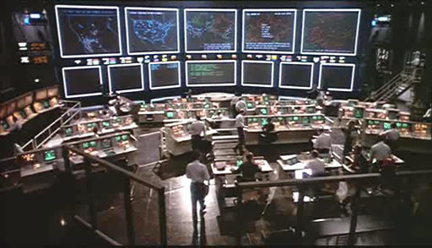
Command & Control
Centralized control
IRC Commands published in IRC channels
(irc.krienaicw.pl #djdjeiu)
HTTP Commands published in web pages
(http://www.myspace.com/angelairiejs/)
Distributed control
P2P Commands and/or “commander” address published in the P2P network (more resilient to take down)
Push vs. Pull
Push The bot silently waits for commands from the “commander"
Pull The bot repeatedly queries the “commander” to see if there is a
new work to do

Slide 44
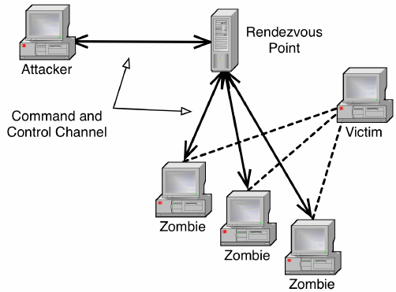
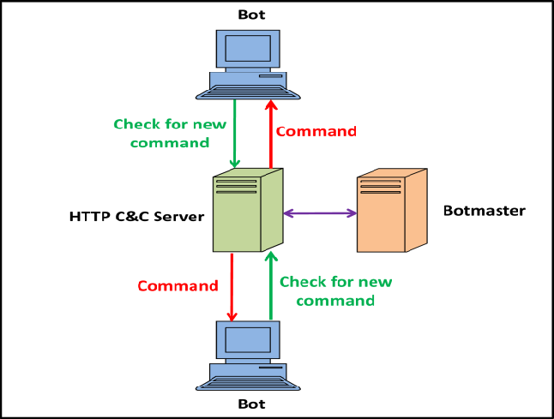
Command & Control
IRC Commands in Channels:
Internet Relay Chat (IRC) has historically been used for C2 communications in botnets.
Malicious actors can publish commands in specific IRC channels, allowing infected machines (bots) to receive instructions directly from a "commander" (the attacker).
Example: Commands such as !attack or !update could be issued in a channel like #djdjeiu on a
server like irc.krienaicw.pl, triggering specific behaviors in the botnet.
2. HTTP Commands on Web Pages:
Some botnets use web pages as a means of communication, where commands are embedded in the HTML or JavaScript.
Bots can periodically check these pages for updates.
Example: An attacker might publish instructions on a
MySpace page (e.g., http://www.myspace.com/angelairiejs/),
which bots would scrape to find new commands or updates.

Slide 45
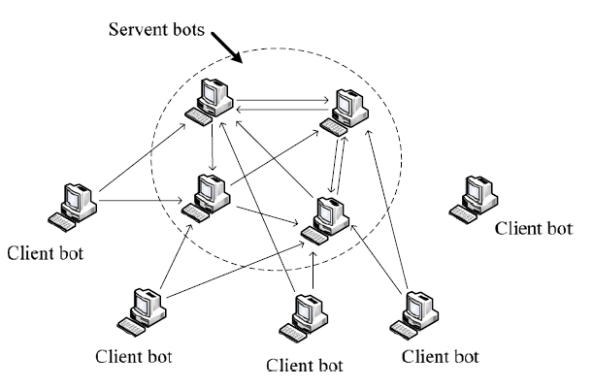
Command & Control
3. Distributed Control: In distributed C2 architectures, control is not centralized, making it harder for authorities to take down the entire network. P2P (peer-to-peer) networks can be employed, where each bot can communicate directly with others and share commands.
Example: P2P commands could be shared among bots in the network, with each bot acting as
both a client and a server.
4. Push vs. Pull
Push:The bot waits silently for commands from the commander. This method is more stealthy, as bots do not actively seek out communications, reducing the chance of detection.
Example: The bot maintains an open connection to the IRC channel, waiting for commands to be pushed to it.
Pull: The bot repeatedly queries the commander to see if there is new work to do. This method can be more resilient to some forms of network disruption, but it may increase the chance of detection.
Example: The bot might regularly make HTTP requests to check if new commands have been posted on a specified web page.

Slide 46

Keylogger
Captures keystrokes to allow attacker to monitor sensitive information
Typically uses some form of filtering mechanism that only returns information close to keywords (“login”, “password”)
Spyware
Subverts the compromised machine to allow monitoring of a wide range of activity on the system
Monitoring history and content of browsing activity
Redirecting certain Web page requests to fake sites
Dynamically modifying data exchanged between the browser and certain Web sites of interest
Notes:
We now consider payloads where the malware gathers data stored on the infected
system for use by the attacker. A common target is the user’s login and password
credentials to banking, gaming, and related sites, which the attacker then uses to
impersonate the user to access these sites for gain. Less commonly, the payload may
target documents or system configuration details for the purpose of reconnaissance
or espionage. These attacks target the confidentiality of this information.
Typically, users send their login and password credentials to banking, gaming, and
related sites over encrypted communication channels (e.g., HTTPS or POP3S),
which protects them from capture by monitoring network packets. To bypass this,
an attacker can install a keylogger , which captures keystrokes on the infected
machine to allow an attacker to monitor this sensitive information. Since this would
result in the attacker receiving a copy of all text entered on the compromised
machine, keyloggers typical implement some form of filtering mechanism that
only returns information close to desired keywords (e.g., “login” or “password” or
“paypal.com”).
In response to the use of keyloggers, some banking and other sites switched to
using a graphical applet to enter critical information, such as passwords. Since these
do not use text entered via the keyboard, traditional keyloggers do not capture this
information. In response, attackers developed more general spyware payloads,
which subvert the compromised machine to allow monitoring of a wide range of
activity on the system. This may include monitoring the history and content of
browsing activity, redirecting certain Web page requests to fake sites controlled by
the attacker, and dynamically modifying data exchanged between the browser and
certain Web sites of interest. All of which can result in significant compromise of
the user’s personal information.
The Zeus banking Trojan, created from its crimeware toolkit, is a prominent
example of such spyware that has been widely deployed in recent years [BINS10].
It steals banking and financial credentials using both a keylogger and capturing and
possibly altering form data for certain Web sites. It is typically deployed using either
spam e-mails or via a compromised Web site in a “drive-by-download.”

Slide 47
Exploits social engineering to leverage the user’s trust by masquerading as communication from a trusted source
Include a URL in a spam e-mail that links to a fake Web site that mimics the login page of a banking, gaming, or similar site
Suggests that urgent action is required by the user to authenticate their account
Attacker exploits the account using the captured credentials
Spear-phishing
Recipients are carefully researched by the attacker
E-mail is crafted to specifically suit its recipient, often quoting a range of information to convince them of its authenticity
Notes:
Another approach used to capture a user’s login and password credentials is to
include a URL in a spam e-mail that links to a fake Web site controlled by the
attacker, but which mimics the login page of some banking, gaming, or similar site.
This is normally included in some message suggesting that urgent action is required
by the user to authenticate their account, to prevent it being locked. If the user is
careless, and doesn’t realize that they are being conned, then following the link and
supplying the requested details will certainly result in the attackers exploiting their
account using the captured credentials.
More generally, such a spam e-mail may direct a user to a fake Web site
controlled by the attacker, or to complete some enclosed form and return to an e-mail
accessible to the attacker, which is used to gather a range of private, personal, information
on the user. Given sufficient details, the attacker can then “assume” the user’s
identity for the purpose of obtaining credit, or sensitive access to other resources.
This is known as a phishing attack and exploits social engineering to leverage user’s
trust by masquerading as communications from a trusted source [GOLD10].
Such general spam e-mails are typically widely distributed to very large numbers
of users, often via a botnet. While the content will not match appropriate
trusted sources for a significant fraction of the recipients, the attackers rely on it
reaching sufficient users of the named trusted source, a gullible portion of whom
will respond, for it to be profitable.
A more dangerous variant of this is the spear-phishing attack. This again is an
e-mail claiming to be from a trusted source. However, the recipients are carefully
researched by the attacker, and each e-mail is carefully crafted to suit its recipient specifically,
often quoting a range of information to convince them of its authenticity. This
greatly increases the likelihood of the recipient responding as desired by the attacker.
This type of attack is particularly used in industrial and other
forms of espionage, or in financial fraud such as bogus wire-transfer authorizations,
by well-resourced organizations. Whether as a result of phishing, drive-by-download,
or direct hacker attack, the number of incidents, and the quantity of personal records
exposed, continues to grow. For example, the Anthem medical data breach in January
2015 exposed more than 78 million personal
information records that could potentially
be used for identity theft. The well-resourced Black Vine cyber-espionage group
is thought responsible for this attack [SYMA16].
Credential theft and identity theft are special cases of a more general reconnaissance
payload, which aims to obtain certain types of desired information and return
this to the attacker. These special cases are certainly the most common; however,
other targets are known. Operation Aurora in 2009 used a Trojan to gain access
to and potentially modify source code repositories at a range of high tech, security,
and defense contractor companies [SYMA16]. The Stuxnet worm discovered
in 2010 included capture of hardware and software configuration details in order to
determine whether it had compromised the specific desired target systems. Early
versions of this worm returned this same information, which was then used to
develop the attacks deployed in later versions [CHEN11, KUSH13]. There are a number of other
high-profile examples of mass record exposure. These include the Wikileaks leak of
sensitive military and diplomatic documents by Chelsea (born Bradley) Manning
in 2010, and the release of information on NSA surveillance programs by Edward
Snowden in 2013. Both of these are examples of insiders exploiting their legitimate
access rights to release information for ideological reasons. And both resulted in
significant global discussion and debate on the consequences of these actions. In
contrast, the 2015 release of personal information on the users of the Ashley Madison
adult website, and the 2016 Panama Papers leak of millions of documents relating to
off-shore entities used as tax havens in at least some cases, are thought to have been
carried out by outside hackers attacking poorly secured systems. Both have resulted
in serious consequences for some of the people named in these leaks.
APT attacks may result in the loss of large volumes of sensitive information,
which is sent, exfiltrated from the target organization, to the attackers. To detect
and block such data exfiltration requires suitable “data-loss” technical countermeasures
that manage either access to such information, or its transmission across
the organization’s network perimeter.

